Slide 1
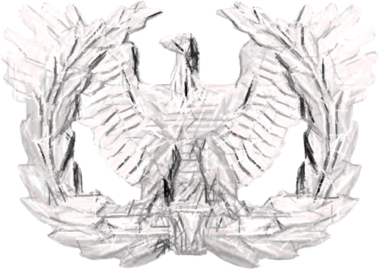
US ARMY WARRANT OFFICERS ASSOCIATION SE Region (5)
MEMBERSHIP
RECENT & UPCOMING ACTIVITES
CHAPTER MEETINGS/ACTIVITIES
FUTURE ACTIONS
Retaining:
Drop List personal email
Expiration Dates
Director Actions:
Personal emails
Zoom/Team meetings
Social Media FB pages
Deputy Director Action:
Email
In Person Visits in Germany
Chapter President Actions:
Email, Calls, & Visits
Actively recruit every Warrant you come in contact with
Report Membership Issues to Director & Deputy
Administered Oath to New and Continuing SOTA President (CW5 Kelsey)
Holiday Parties
Re-establishing in person meetings, while reassuring the Online thru Zoom meetings
Activities resuming
Council of Presidents (COP) via Teams
2022 AMM Fort Bragg, NC
FUNDRAISING (possibilities)
Holiday wrapping

